Slide 1
L02.01 sorting, master theorem
50.004 Introduction to Algorithm
Dr. Simon LUI
ISTD, SUTD

Slide 2
Objective
Explain the sorting problem
Insertion sort is O(n²)
Merge sort is O(nlogn) (by divide and conquer)
Analyze complexity of recursions
By induction: the substitution method
By expansion: the recursion tree method

Slide 3
Sorting problem
Input: an array A[0..n-1] of numbers
Output: B. (a permutation of A) such that
in-place sort: if the sorted item occupy the same storage as the original one.
Out-of-space sort: if the sorting algorithm used extra space to do the sorting
Notes:
Questions: fastest way?
Think of a way to sort a list

Slide 4
Insertion sort

Slide 5
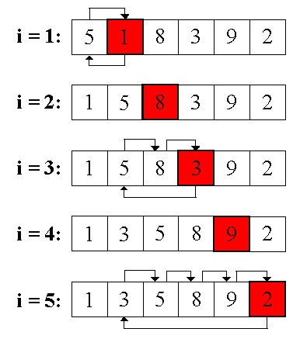
Insertion sort
sorted
1
3
4
4
6
6
8
9
5
3
7
Principle: A[1:i-1] is sorted
Then, put A[i] in the right position
For i in range(1,n):
while A[i]<A[i-1]:
swap A[i] with A[i-1]
i -= 1
Notes:
Is it in place?

Slide 6
Complexity of insertion sort
Worst-case running time T(n) on an input of size n
T(n)

Slide 7
Divide and Conquer - revision

Slide 8
Divide and conquer solution
Key idea:
Divide input into parts (smaller problems)
Conquer (solve) each part recursively
Combine results to obtain solution of original
Notes:
Exercise: guess merge sort

Slide 9
Lets construct the recursion!

Slide 10
Lets construct the recursion!

Slide 11
Lets construct the recursion!

Slide 12
Lets construct the recursion!

Slide 13
Lets construct the recursion!
Read n numbers
2 x
Sort n/2 numbers
Merge n numbers

Slide 14
… Syntax for your reference
A = [2,4,6,8,10]
A[] = [2,4,6,8,10]
A[0] = [2]
A[1] = [4]
A[1:3] = [4,6,8]
A[0:2] = [2,4,6]
A[:2] = [2,4,6]
A[1:] = [4,6,8,10]

Slide 15
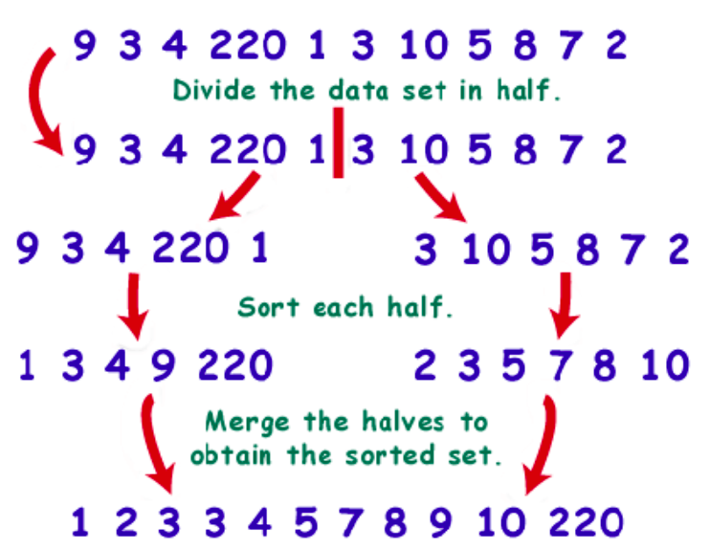
Merge sort
A
MergeSort(A):
if n=1: done –> return
recursively sort A[:n/2] -> L
recursively sort A[n/2:] -> R
merge L & R -> output A’
A’
Time:
divide: Θ(n)
recursion: n₁=n₂=n/2
time = T(n₁)+T(n₂)=2T(n/2)
merge: Θ(n) total
T(n)=2T(n/2)+Θ(n)
Notes:
In place?

Slide 16
Solve the recurrence formula

Slide 17

Solving recurrences by expansion (recursion tree)
The recursion tree = sum of cost of nodes
Example 1, Let’s draw the tree of:

Slide 18
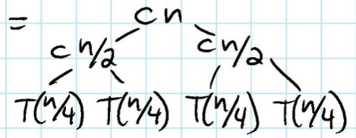
Solving recurrences by expansion (recursion tree)
The recursion tree = sum of cost of nodes

Slide 19
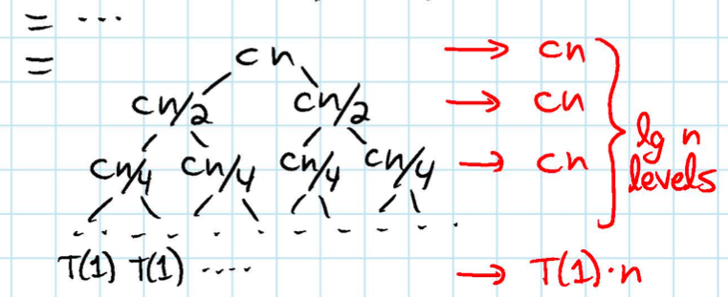
Solving recurrences by expansion (recursion tree)
The recursion tree = sum of cost of nodes
Sum each level, then sum all levels

Slide 20
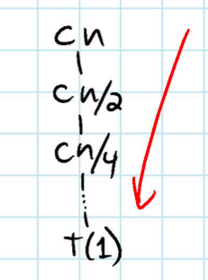
Solution by expansion (recursion tree)
Example 2, The recurrence tree of
Yes, T(n) = T(n/2) + cn is not referring to the 1D peak finding problem
The 1D peak finding problem is T(n) = T(n/2) + c
- So every levels are equal (every level sum up to c)
- according to the master theorem rule no.2,
a=1, b=2, f(n)=c.
every layer are equal
so T(n) = THETA(n^log1 logn) = THETA(logn)

Slide 21
Master Theorem

Slide 22
Can we generalize our observations?
There are three cases
Each level’s value is the same
Total value = Θ(number of levels x sum of each level)
Each level’s value is decreasing
total value = Θ(root node’s value)
Each level’s value is increasing
total value = Θ(number of leaves)
Since each level node is Θ(1)

Slide 23
What is master theorem
The master Theorem can find the complexity of T(n), according to f(n)

Slide 24
The Master Theorem
…
..…
……………….
L
i.e. value of f(n) is
geometrically increasing
down the tree

Slide 25
The Master Theorem
…
..…
……………….
L
i.e value of each level
are (roughly) equal

Slide 26
The Master Theorem
…
..…
……………….
L
i.e. the value of f(n)
Is geometrically decreasing
down the tree

Slide 27
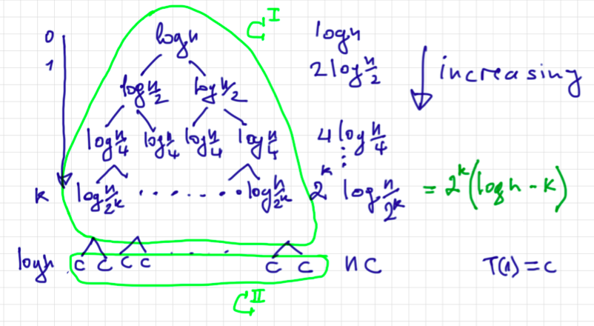
Examples
The master theorem
f(n) = log n, a = 2, b = 2
The values of each level are geometrically increasing down the tree
So,

Slide 28
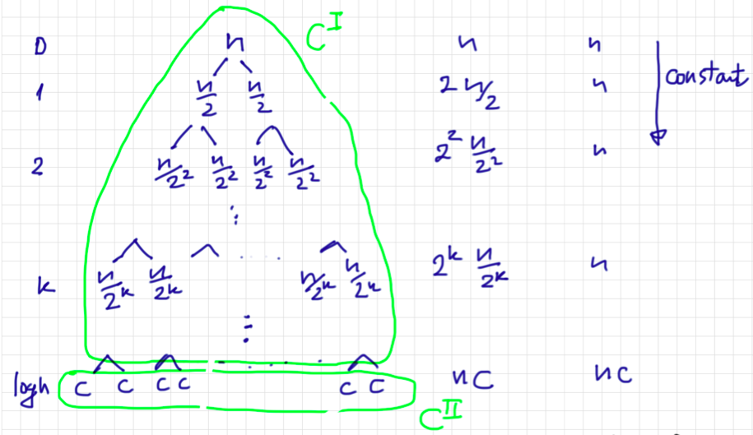
Examples
The master theorem
f(n) = n, a = 2, b = 2
The values of each level are geometrically equal
So,

Slide 29
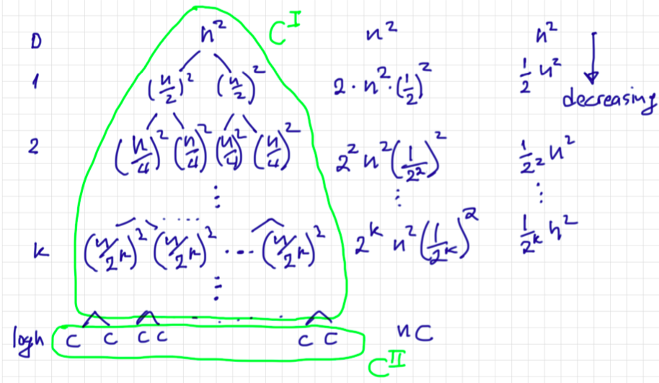
Examples
The master theorem
f(n) = n², a = 2, b = 2
The values of each level are geometrically decreasing down the tree
So,

